Slide 1
Project Review-3
AI-Driven Loan Default Prediction Using Banking Analytics
An Explainable Machine Learning Framework Across Three Public Credit Datasets
S. Tejasree, B. Sruthi, B. Bhavya Sai Sree
Guide: Dr. K. Swapnika
Department of Computer Science and Engineering
KLH University, Hyderabad

Slide 2
Background and Problem Statement
A loan default happens when a borrower stops repaying as agreed, and the bank bears the loss.
Defaulted loans that stay unpaid become non-performing assets (NPAs), which reduce a bank’s profit and capital.
Traditional credit scoring uses fixed rules and a few variables. It handles non-linear patterns poorly.
A score alone does not tell the bank why an applicant was rejected.
So the model must be accurate and also explain its decisions.
Project focus
Predict loan default
Compare ML models
Explain results with SHAP and LIME

Slide 3
Research Gap and Objectives
Research gaps
Objectives
Research questions
Accurate models are often hard to interpret
Many studies use only one dataset
Baseline and hybrid models are rarely compared on the same data
Preprocess three public credit datasets
Train five baseline models
Build and evaluate a hybrid model
Explain predictions with SHAP and LIME
Present results in a dashboard
How do the baseline models compare across datasets?
Does the hybrid model improve on them?
Which features drive default risk?
Wording to be matched with the Review-2 slides.

Slide 4
Dataset Description
Dataset | Description | Why it is used
Lending Club | Peer-to-peer loan records with borrower details and repayment status | Large real-world data for default prediction
Statlog German Credit | Applicants labelled as good or bad credit risk | Small standard benchmark
Home Credit | Loan applications from borrowers with limited credit history | Many features, imbalanced classes
Why separate evaluation: the datasets differ in size, features, class balance and data quality. Testing each one separately shows whether the models hold up beyond a single dataset.

Slide 5
Validated Methodology
Step | Status
Data collection | To confirm
Data cleaning | To confirm
Missing-value handling | To confirm
Encoding of categorical features | To confirm
Class imbalance handling | To confirm
Step | Status
Exploratory data analysis | To confirm
Feature engineering | To confirm
Model training | To confirm
Model evaluation | To confirm
Status options: Completed / In Progress / Pending. Mark Completed only where output exists.

Slide 6
System Workflow
Datasets
Preprocessing and EDA
Feature Engineering
Baseline Model Training
Dashboard
SHAP / LIME Explainability
Performance Evaluation
Proposed Hybrid Model

Slide 7
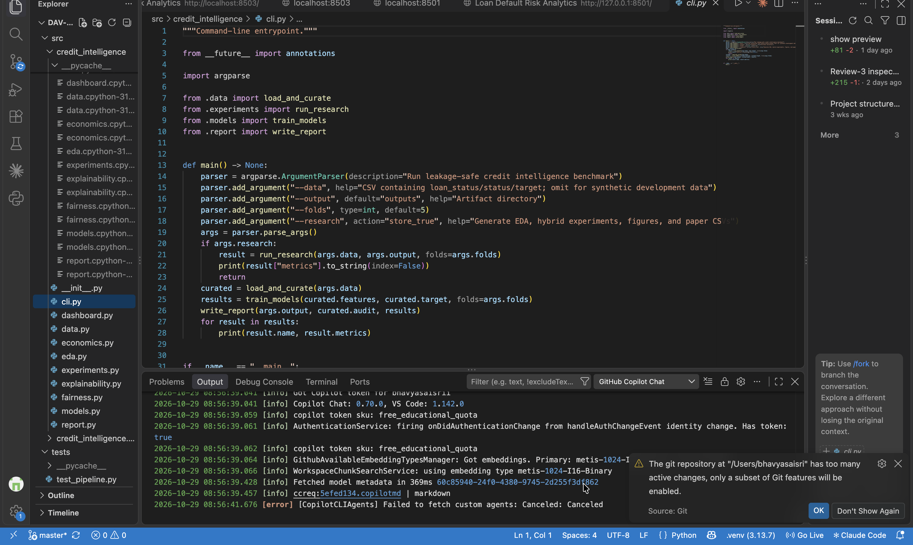
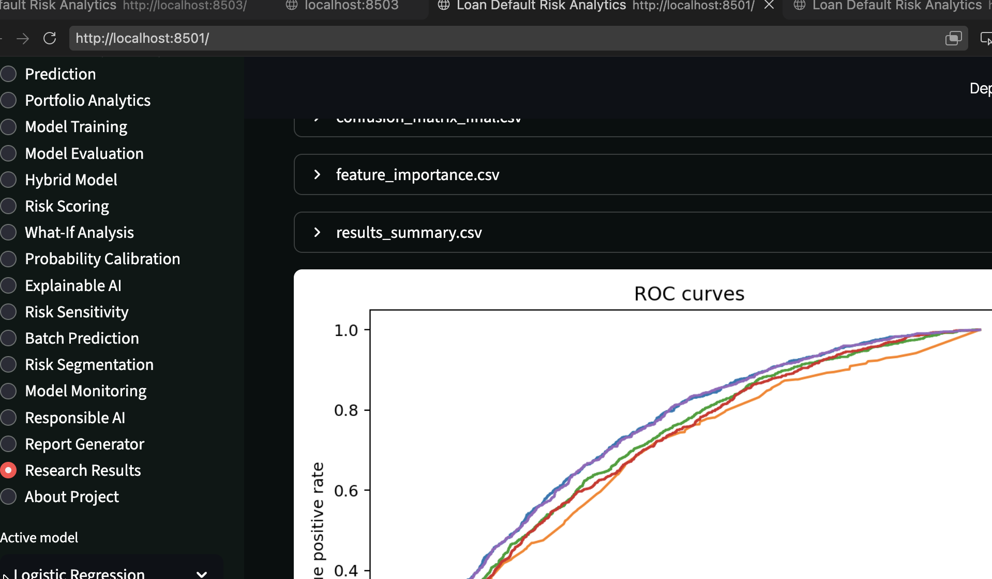
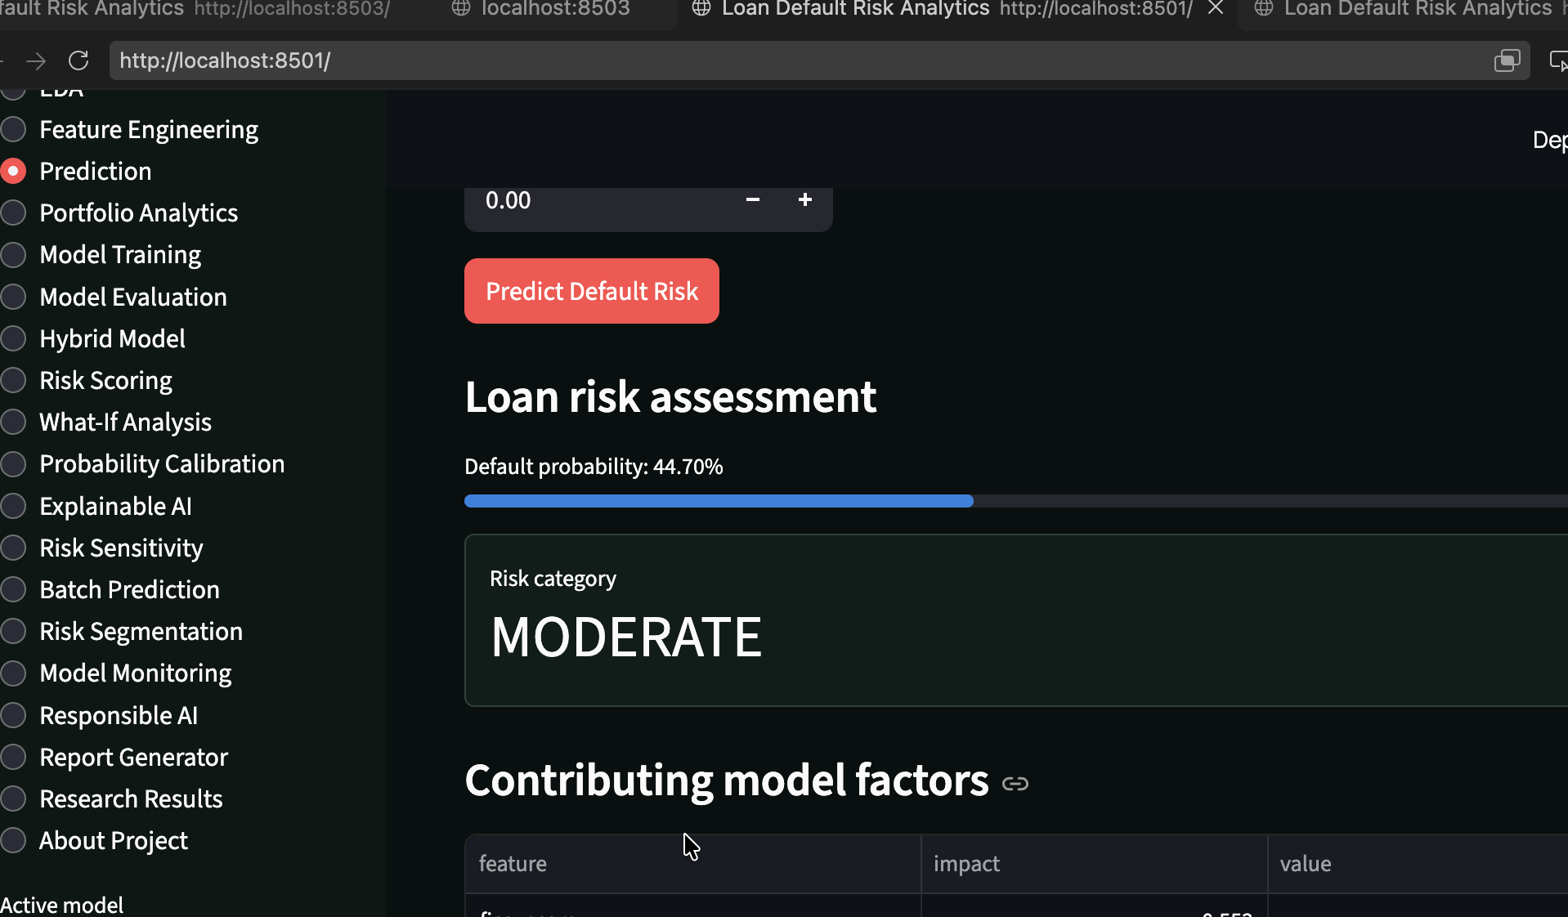
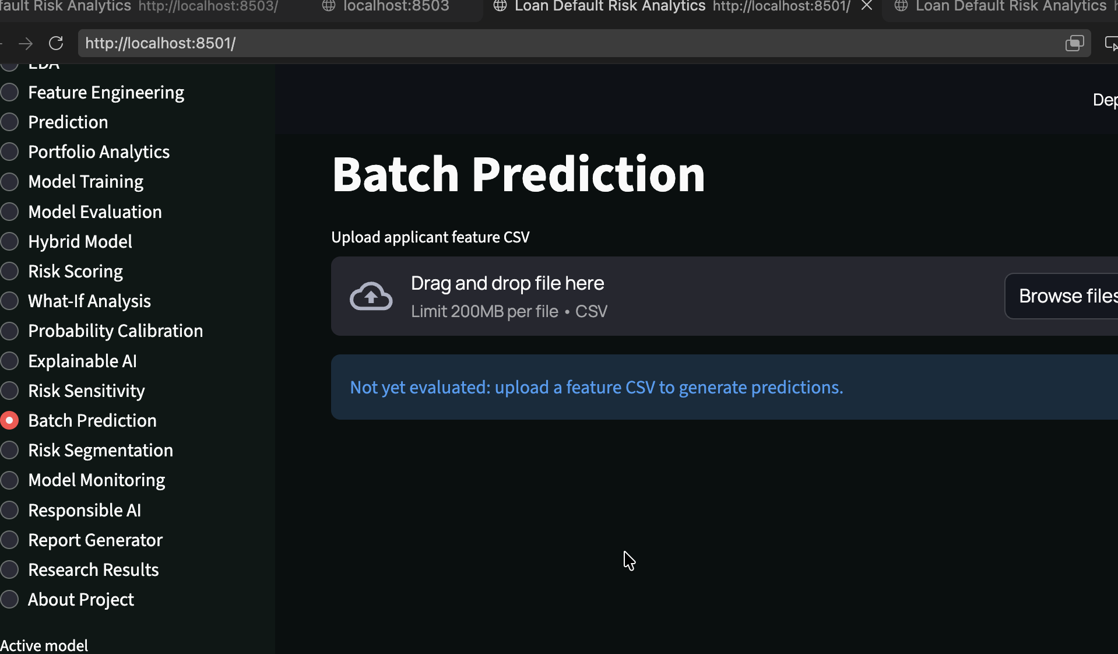
Code Implementation and Execution
Screenshot: Python code
Screenshot: model execution
Module | Status
Preprocessing | To confirm
EDA | To confirm
Feature engineering | To confirm
Baseline models | To confirm
Hybrid model | To confirm
Evaluation | To confirm
SHAP / LIME | To confirm
Dashboard | To confirm
Screenshot: preprocessing output
Screenshot: evaluation results

Slide 8
Baseline Machine Learning Models
Model | Type | Role in the comparison
Logistic Regression | Linear | Simple, interpretable reference
Decision Tree | Single tree | Rule-based, easy to read
Random Forest | Bagged trees | Reduces variance of one tree
XGBoost | Gradient boosting | Strong tabular-data baseline
CatBoost | Gradient boosting | Handles categorical features directly
All five use the same data splits and metrics, so the hybrid model is compared against the same baselines.

Slide 9
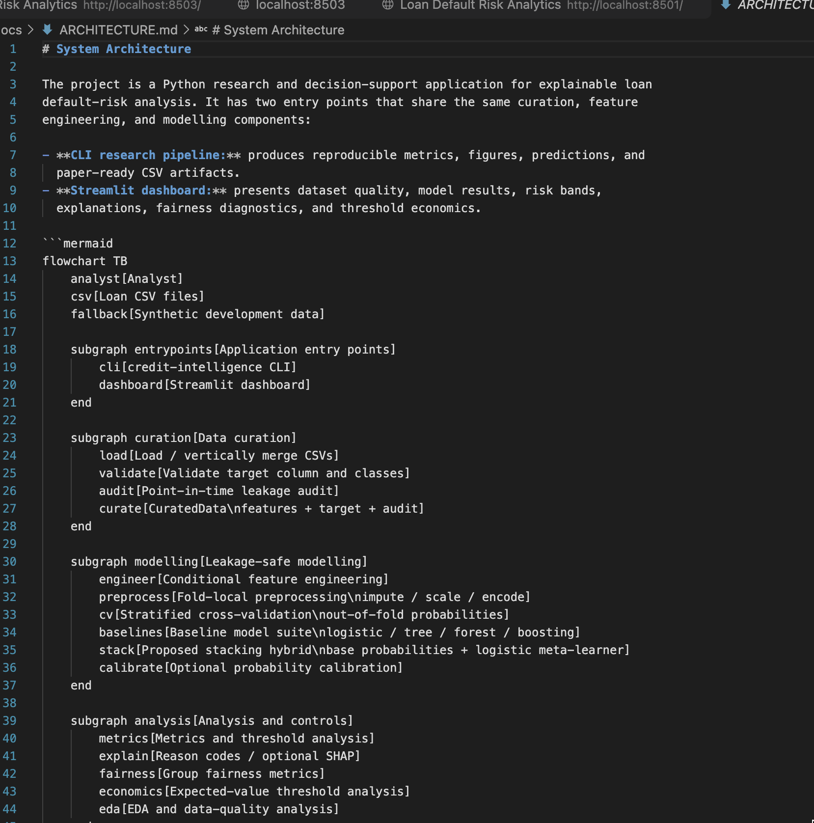
Proposed Hybrid Model
Status: In Progress
Insert architecture diagram once the hybrid model is implemented
To be documented
Component models
How their outputs are combined
Training and validation setup
Reason for evaluating this approach
Comparison with the five baselines

Slide 10
Comparative Analysis
Model | Accuracy | Precision | Recall | F1-score | ROC-AUC
Logistic Regression | Pending Evaluation | Pending Evaluation | Pending Evaluation | Pending Evaluation | Pending Evaluation
Decision Tree | Pending Evaluation | Pending Evaluation | Pending Evaluation | Pending Evaluation | Pending Evaluation
Random Forest | Pending Evaluation | Pending Evaluation | Pending Evaluation | Pending Evaluation | Pending Evaluation
XGBoost | Pending Evaluation | Pending Evaluation | Pending Evaluation | Pending Evaluation | Pending Evaluation
CatBoost | Pending Evaluation | Pending Evaluation | Pending Evaluation | Pending Evaluation | Pending Evaluation
Proposed Hybrid Model | Pending Evaluation | Pending Evaluation | Pending Evaluation | Pending Evaluation | Pending Evaluation
Interpretation: to be written after the results are generated. Results will be reported per dataset.

Slide 11
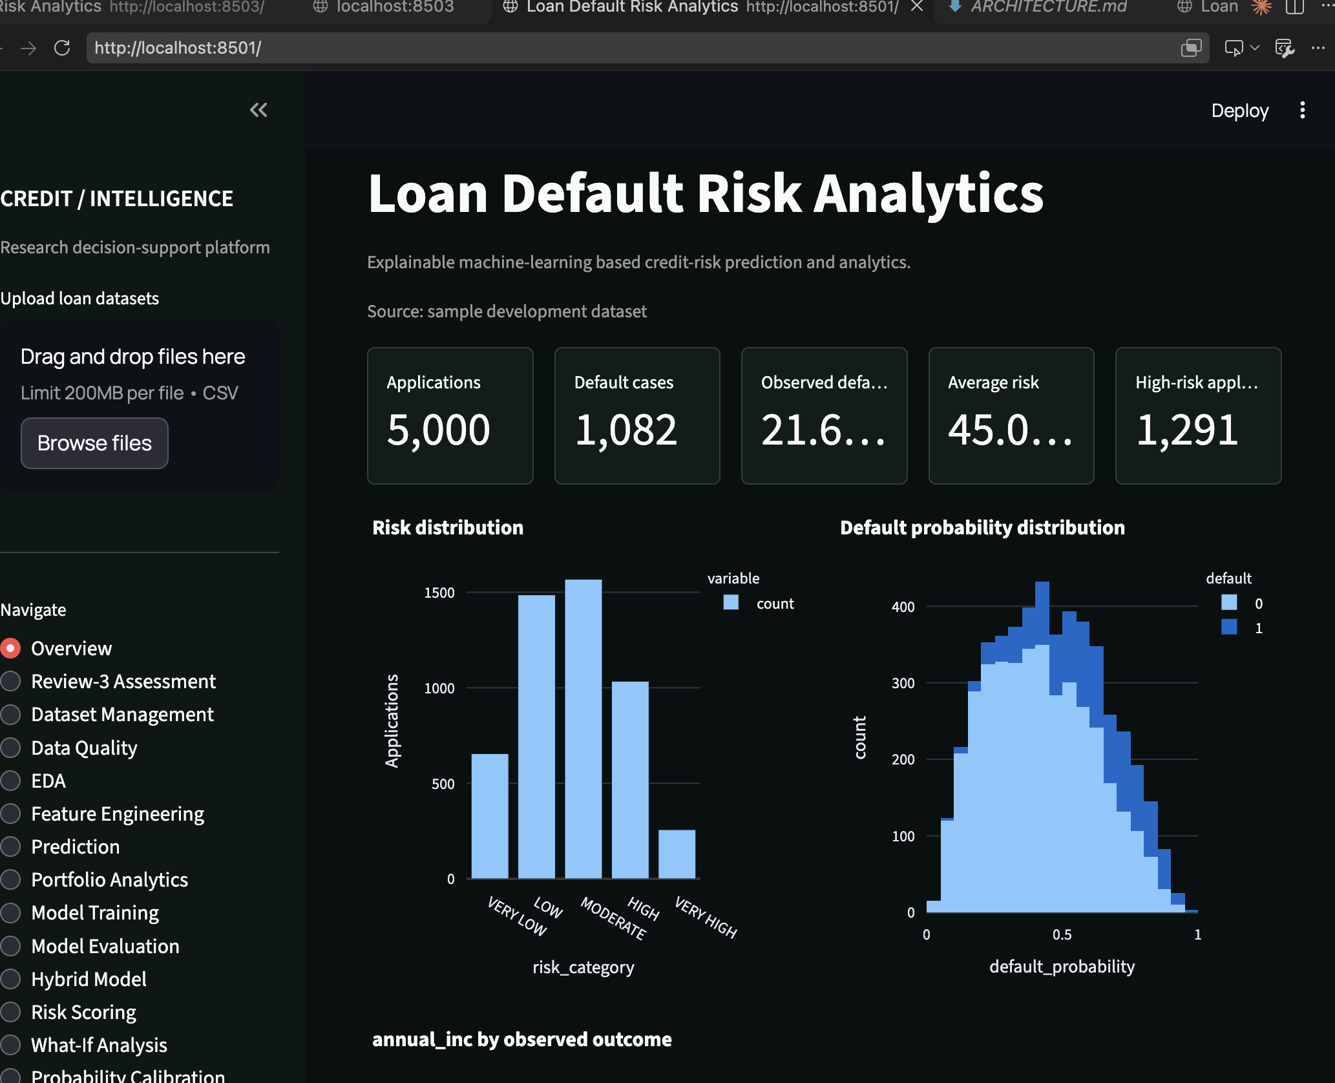
Dashboard Execution
Status: In Progress (to confirm)
Screenshot: running dashboard
Planned features
Model performance comparison
Feature importance
Individual prediction explanations
Loan-risk insights

Slide 12
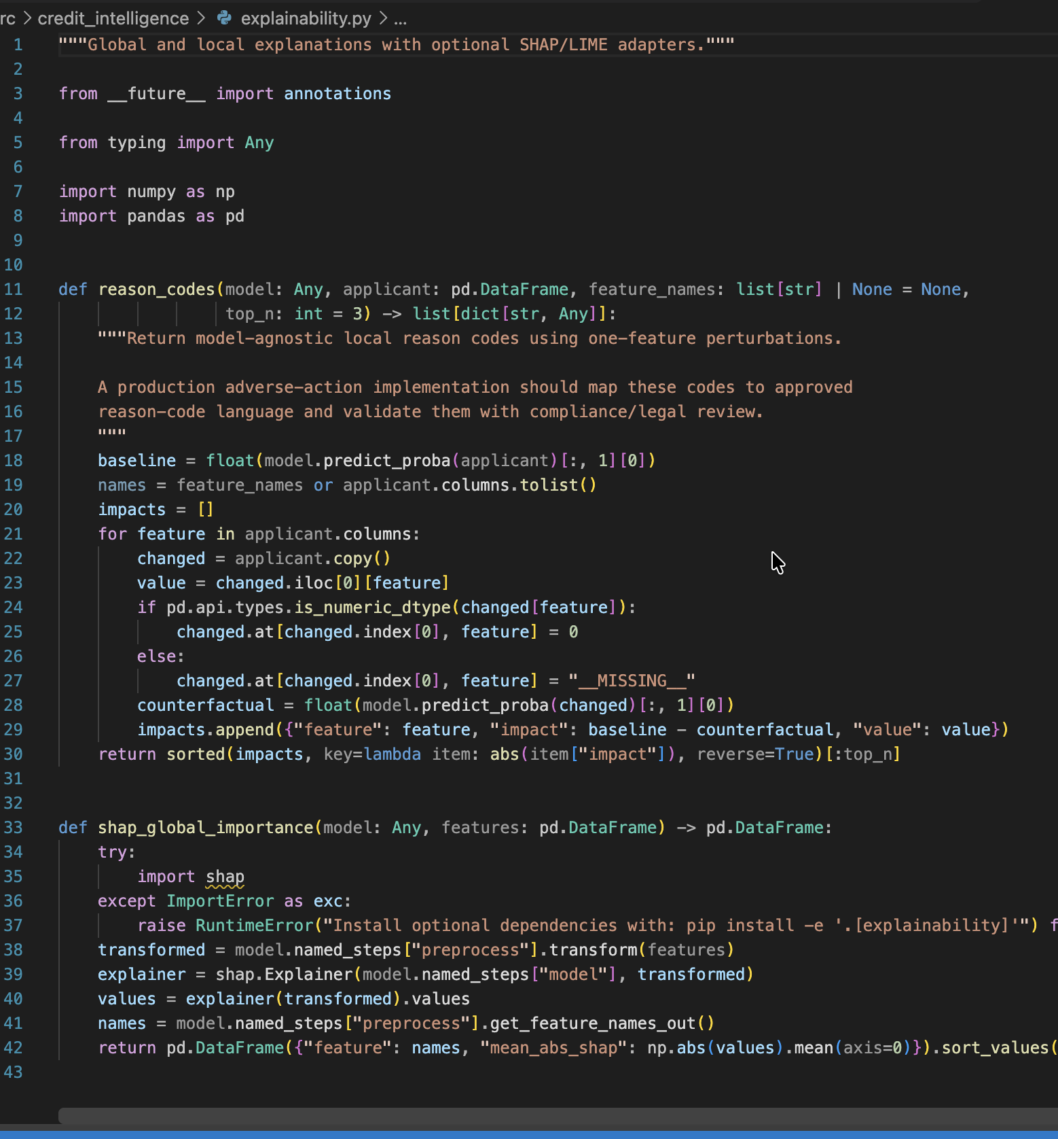
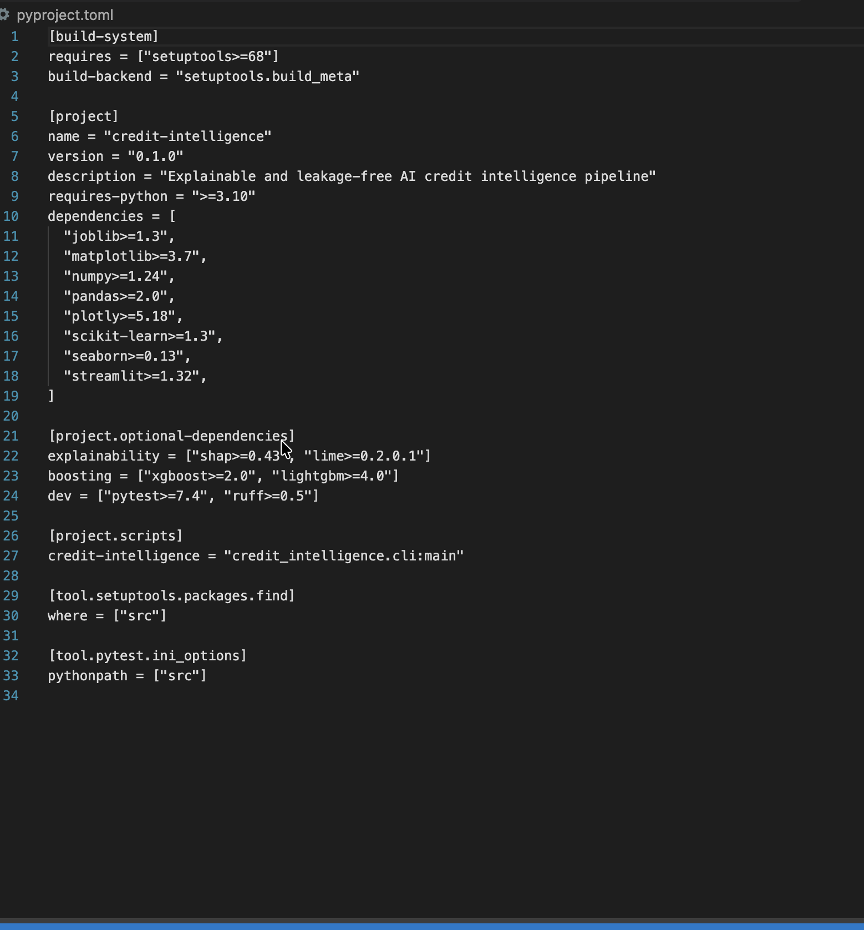
Explainable AI
SHAP: global importance
LIME: individual predictions
Shows which features influence predictions most across all applicants.
Explains why one applicant was classified as high or low risk.
SHAP plot (insert if available)
LIME explanation (insert if available)

Slide 13
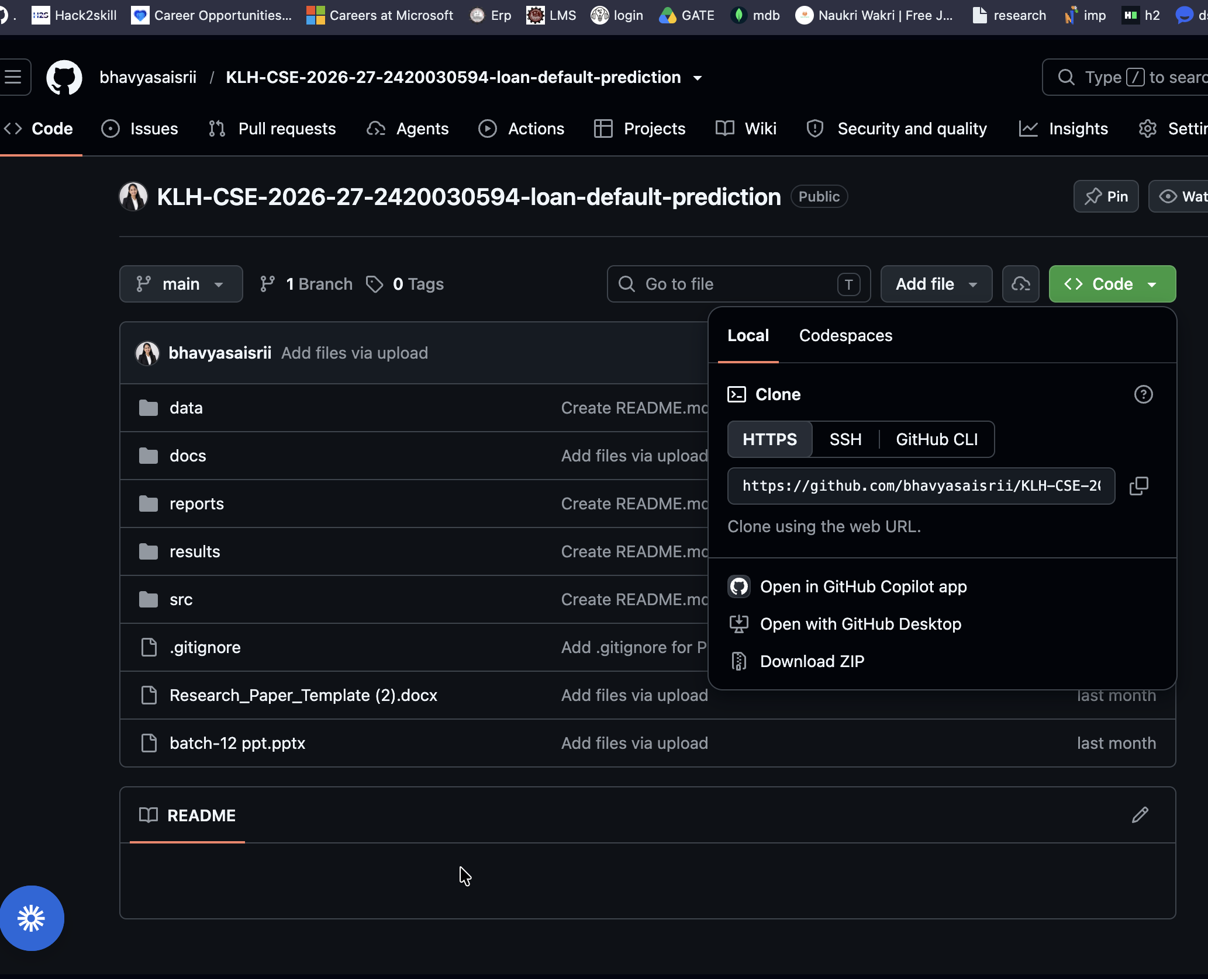
GitHub Repository and Research Paper Progress
Repository: [insert GitHub URL]
Paper section | Status
Abstract | To confirm
Introduction | To confirm
Literature review | To confirm
Methodology | To confirm
Implementation / results | To confirm
Discussion | To confirm
Conclusion | To confirm
References | To confirm
Project directory structure (paste from repository)
Screenshot: recent commits

Slide 14
Conclusion, Limitations and Future Work
Completed work
Limitations
[list verified items]
Results cover only the three public datasets. Hybrid model, evaluation and dashboard are still being finalised.
Pending implementation
Next steps
[list items still in progress]
Generate all metrics, finish the hybrid model and dashboard, complete the paper, run the final evaluation.

Slide 15
References
Paste the references from the Review-2 presentation here
Thank You
Questions are welcome

